Slide 1
CSE 3200 - System Development Project
NOBANNO
An Android App for Rice Plant Disease Recognition
Prepared By:
Tahsin Mahmud
Roll:1707019
MD.Tamim Hossain
Roll:1707020
Supervisor:
Jakaria Rabbi
Assistant Professor
Department of Computer Science and Engineering
Khulna University of Engineering & Technology

Slide 2
Outline
Motivation
Problem Statement
Objectives
Scope of Study
Literature Review
Methodology
Data Collection
Classification
Overview of the System
Analysis
App Design
Results
Training Accuracy & Validation & Loss
App Features
App Layout
Limitations
Reference

Slide 3
Motivation
Bangladesh is well known for agricultural production.
Farmers of our country cultivate different varieties of crops and rice is one of them.
Rice is the main food of Bangladesh.The large part of our economy is directly or indirectly dependent on rice.
Rice sector contributes one-half of the agricultural GDP and one-sixth of the national income in Bangladesh.
Disease is one of the main problems in rice cultivation of Bangladesh.
25 % of yield crops are destroyed due to diseases.
This can be reduced if farmers can detect the affected crops quickly and take necessary measures.
We have built an Android Application which will detect the disease of affected crop and give primary treatments.
Date: 24.06.2021

Slide 4
Problem Statement
Two most common fungal diseases Leaf Blast and Brown Spot, and the pest Hispa that attacks rice crops and causes immense damage.
Leaf Blast is a fungal disease that affects all parts of the rice plant like the node, neck, leaf sheath and parts of the panicle. It can attack the plant through all growth stages.It appears as whitish grey or greenish spots which then develop a necrotic border and a reddish-brown center
Brown Spot is another fungal disease that attacks the leaf sheath, panicles, glumes and the coleoptile. This disease can impact the future crops as well through infected seeds.It appears as small yellow-brown lesions on the leaf and can evolve into a red bordered spot with a grey or light brown core.
Hispa is not a disease but a pest. Adult Hispa is a beetle that is around 5 mm in length. It feeds by scraping the surface of the leaf as a result of which white lines appear on the leaf’s surface.
Date: 24.06.2021

Slide 5
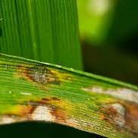
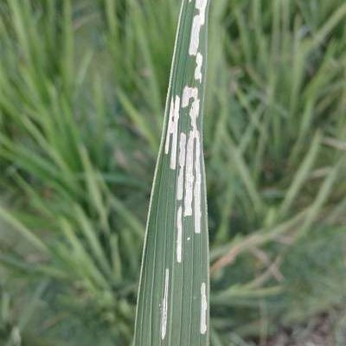
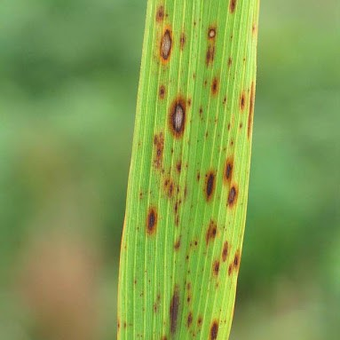
Problem Statement
(a)
(b)
(c)
Fig 1 (a) Leaf Blast, (b) Hispa, (c) Brown Spot
Date: 24.06.2021

Slide 6
Objectives
Deploy modern deep learning frameworks like MobilenetV2, VGG16 and InceptionV3 and a Keras CNN model
Access the huge dataset obtained from Kaggle and classify images into four categories(Leaf Blast, Brown Spot, Healthy , Hispa)
Build an android app by utilizing the deep learning methods to classify the diseases
Build a simple user interface of the app so that farmers can easily use it
Providing primary treatments and detected disease demonstration to the farmers so that they can take necessary measures before it’s too late.
Date: 24.06.2021

Slide 7
Scope of Study
Use other deep learning frameworks(ResNet50, ResNet50V2, AlexNet and Vgg19) and compare the accuracy of them with the existing models.
Add more diseases(Bacterial, Sheath rot , Leaf scald, Brown spot, Grain spot ) to detect more variety.
Go to an on field survey to have more practical experience of how the application is working.
Date: 24.06.2021

Slide 8
Literature Review
Santanu Phadik Ar and Jaya Sil aimed to detect plant diseases using Deep Learning techniques that will help the farmers to quickly and easily detect diseases which in turn would enable The farmers to take proper steps at an early stage. The highest accuracy of prediction of this model is 86.799%.
A higher accuracy was found in paper where a plant disease detection model was developed using CNN. This model can identify 13 different types of diseases of plants. The final accuracy achieved from this model is 96.3%.
In another study , the affected parts were separated from the rice leaf surface using K-means clustering and the model was then trained with SVM using color, texture and shape as the classifying features.
Date: 24.06.2021

Slide 9
Methodology
The basic methodology of this project is indicated in the steps below:
Fig 3.2 Deep Learning Block Diagram
Date: 24.06.2021

Slide 10
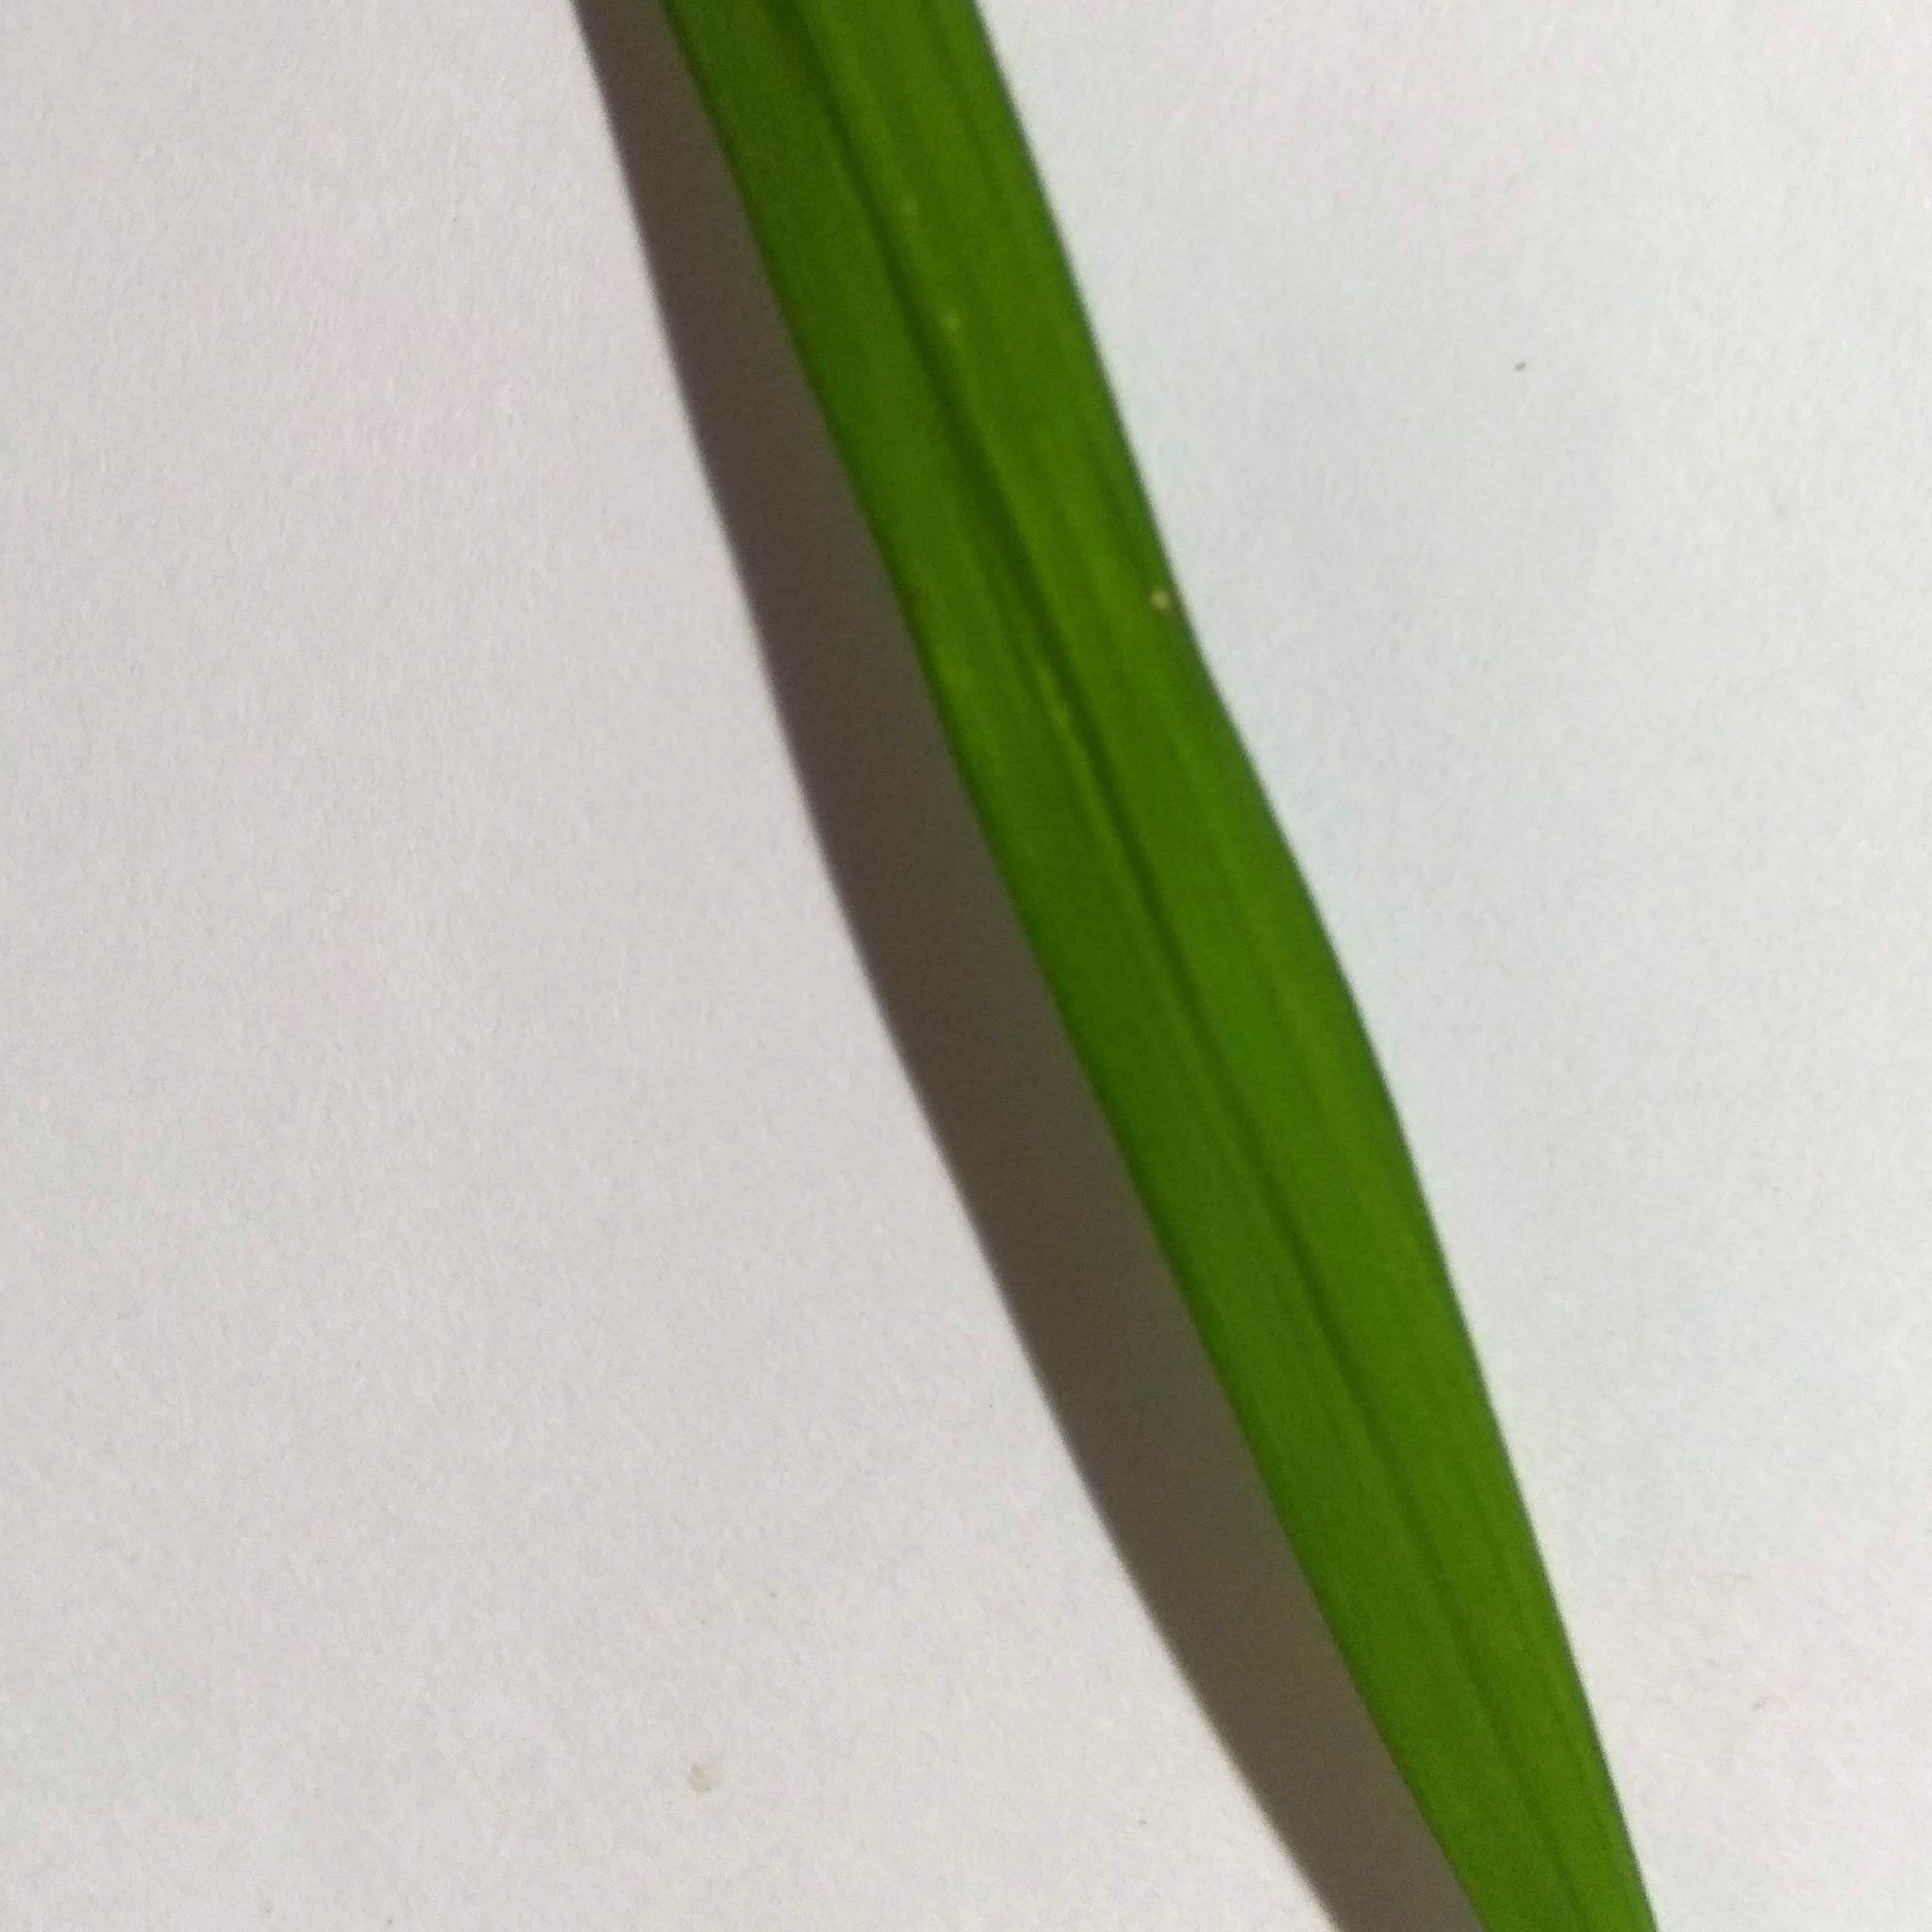
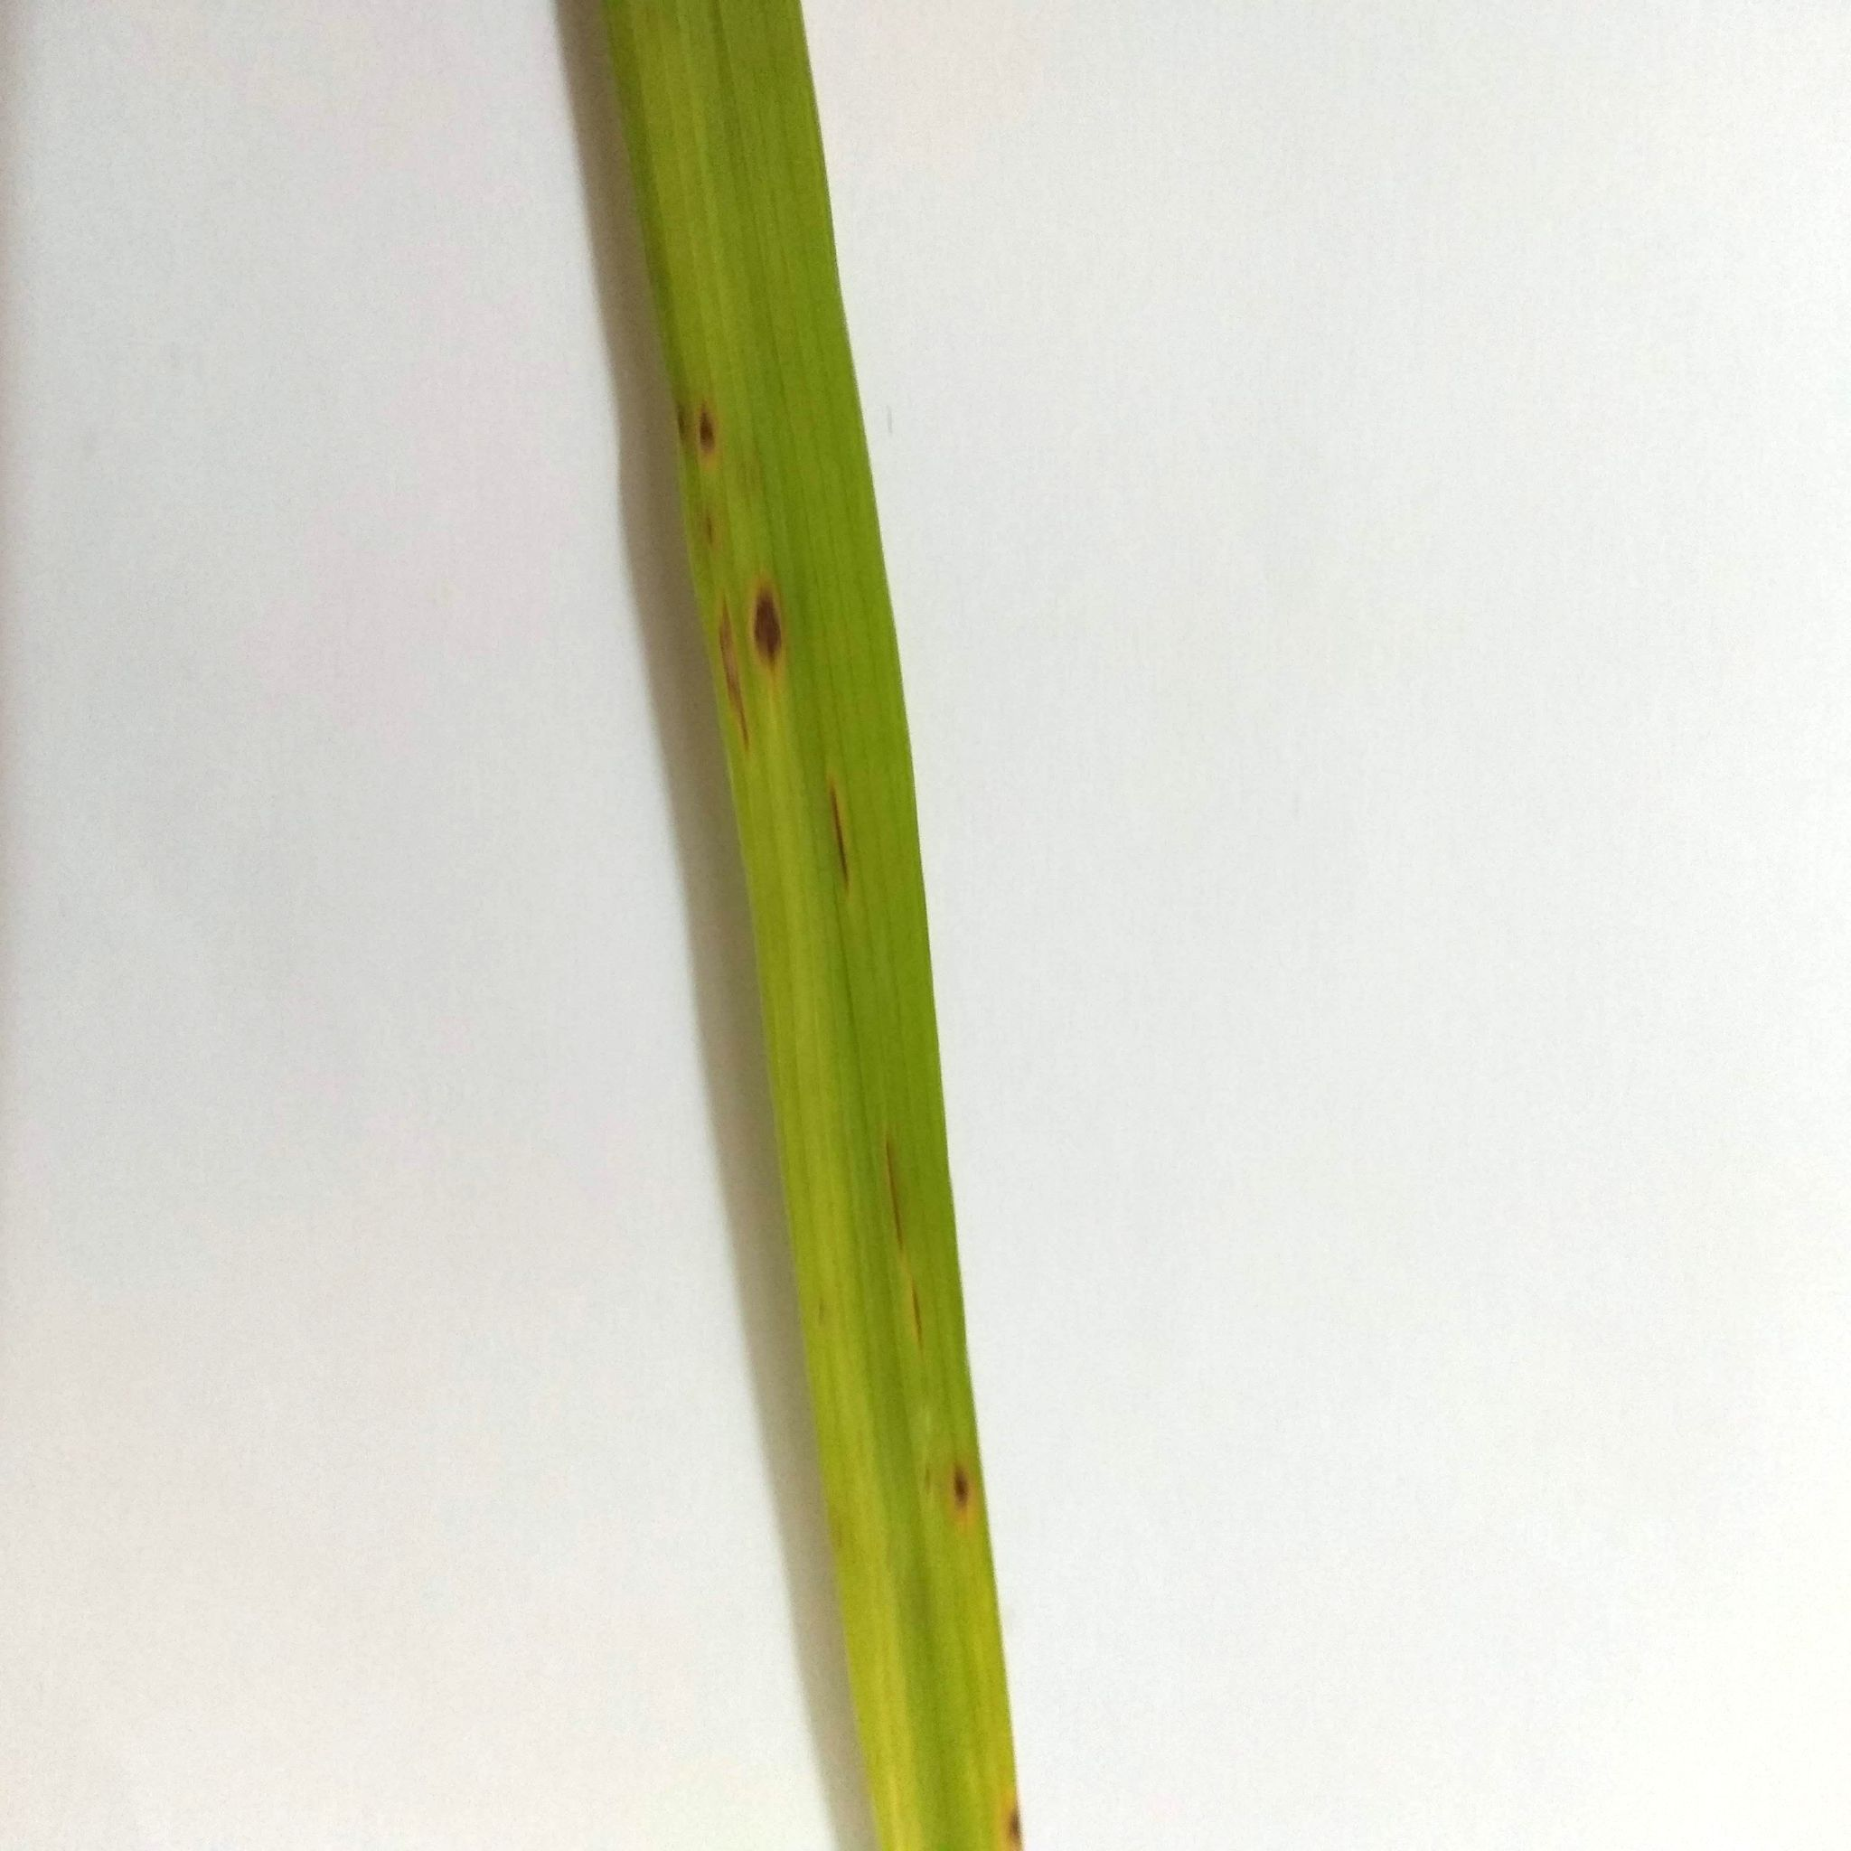
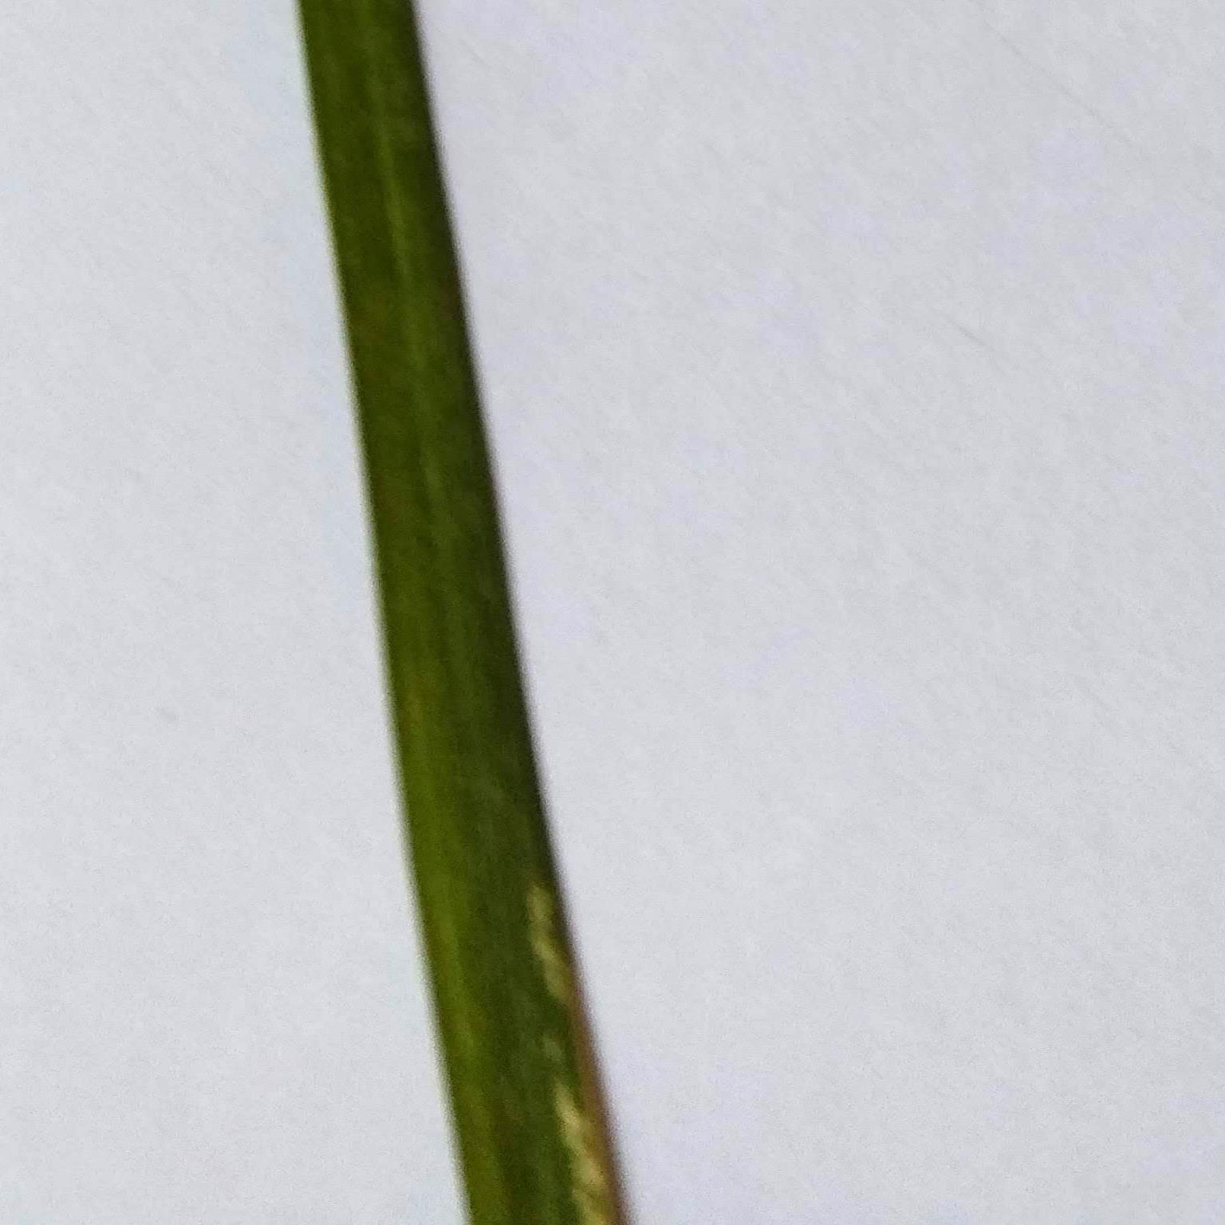
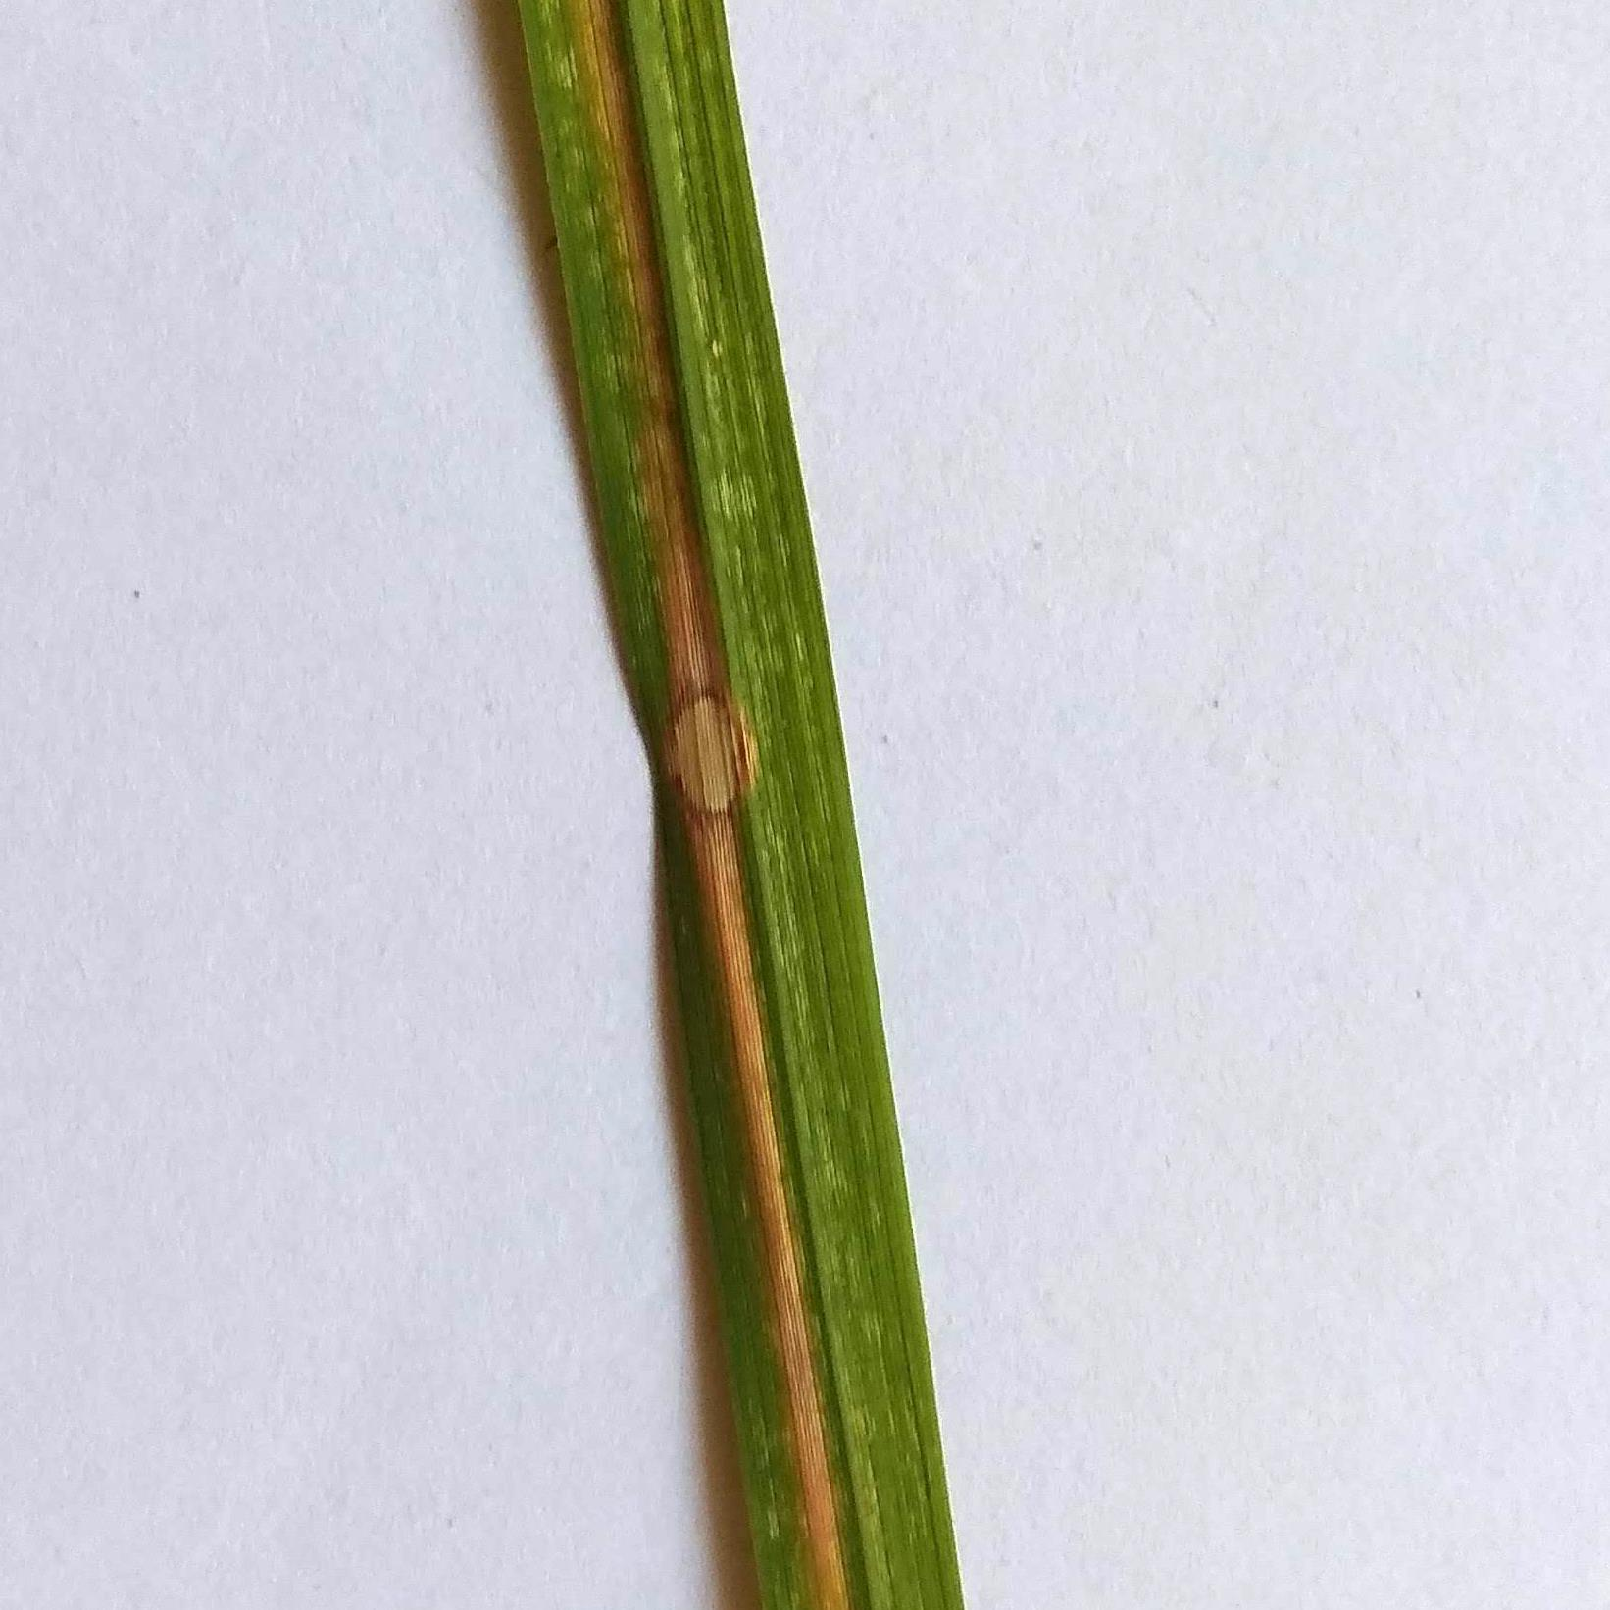
Data Collection
Artificial rice leaf images were obtained through Kaggle and comprised of a total of 3355 images belonging to four different classes i.e. Healthy, Hispa (pest), Brown Spot and Leaf Blast (diseases). This was an ideal data set as the images had a clean background and there was only one leaf per image
(a)
(b)
(c)
(d)
Fig 2 (a) Healthy, (b) Brown Spot, (c) Hispa, (d) Leaf Blast
Date: 24.06.2021

Slide 11
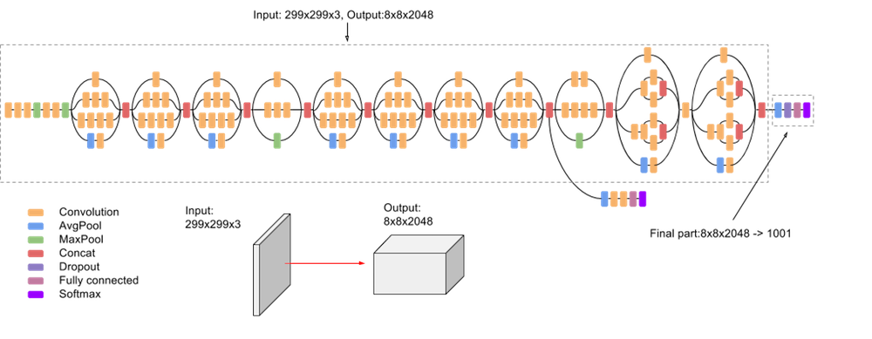
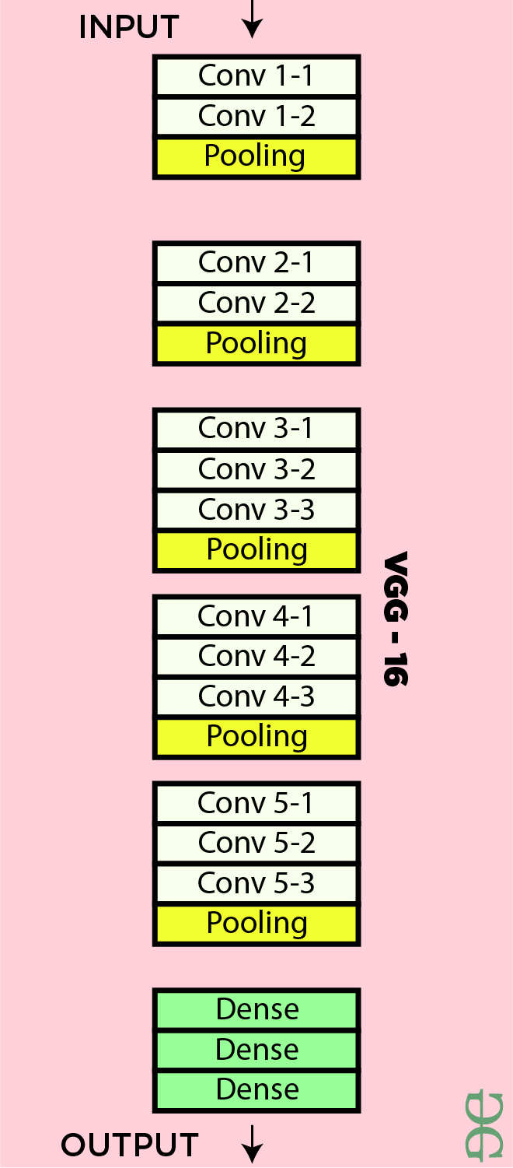
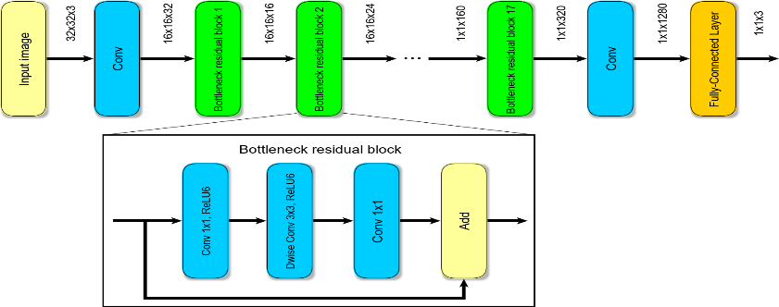
Classification
(a) MobileNet Architecture
(b)InceptionV3 Architecture
(c) VGG16 Architecture
Date: 24.06.2021

Slide 12
Overview of the System
We used Keras framework with tensorflow backend to train our models with our training set.
After each epoch of training, we evaluated the performance of the model on our validation. set.
If the validation accuracy exceeded the best validation accuracy we had got so far, we saved this model. In this way, we always saved the model with the best validation accuracy so far during training.
After training for 40 epochs, we stopped training and evaluated the performance of the model on our test set.
Date: 24.06.2021

Slide 13
Analysis
We have used four models (Keras CNN, InceptionV3, MobilenetV2 and VGG16)
Compared the accuracy of the models.
Then converted the model with the highest accuracy into tensorflow lite model. Then deployed the model into an android application.
Date: 24.06.2021

Slide 14
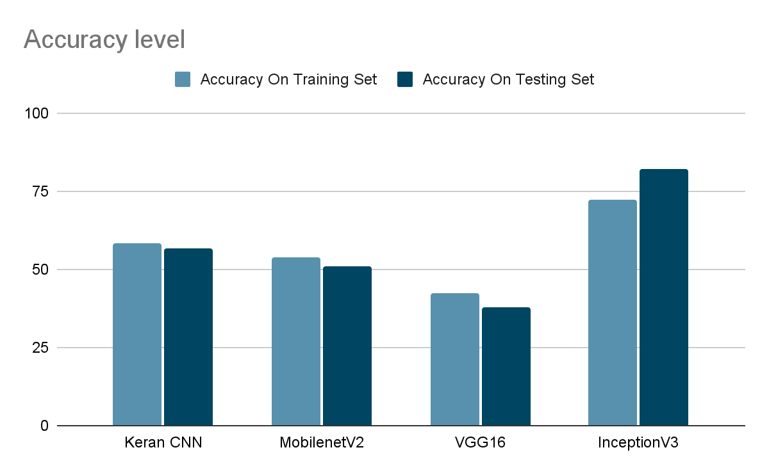
Results
Date: 24.06.2021

Slide 15
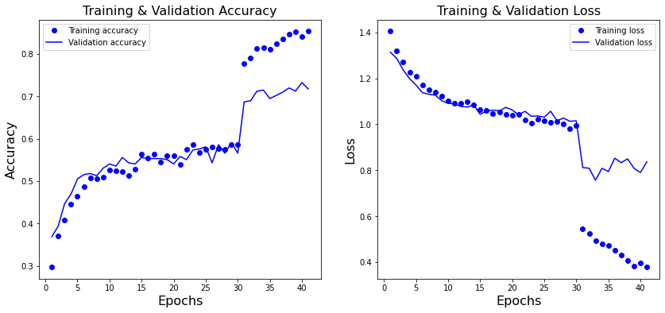
Training & Validation Accuracy & Loss
Fig 4: Training & Validation Accuracy
Fig 6: Training & Validation Loss
Date: 24.06.2021

Slide 16
App Design
Fig 4: Block Diagram of Android Application
Date: 24.06.2021

Slide 17
App Features
Detects three different diseases ( Hispa, Leaf Blast, Brown Spot).
Can detect healthy crops without any disease.
Gives demonstration and an idea of after effects of the detected disease.
Gives primary treatment for the detected disease.
Date: 24.06.2021

Slide 18
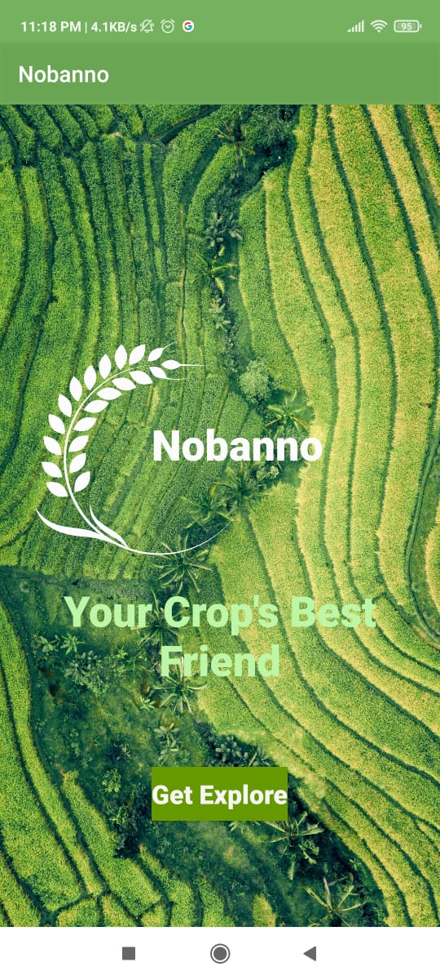
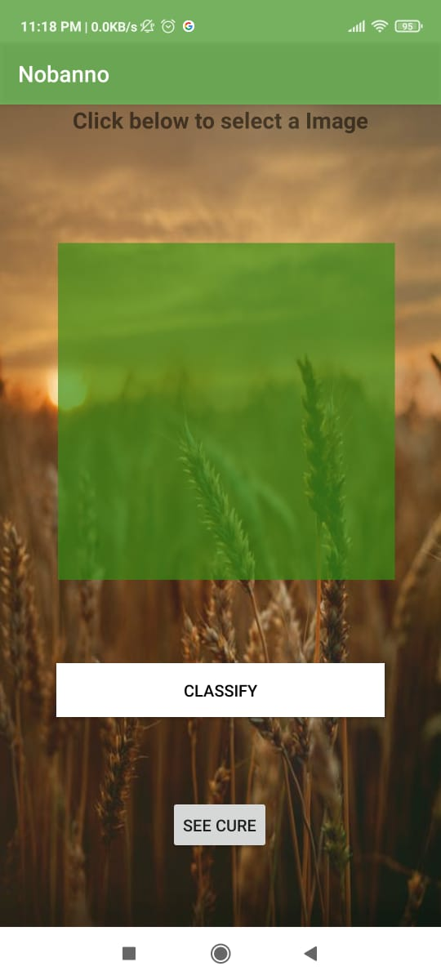
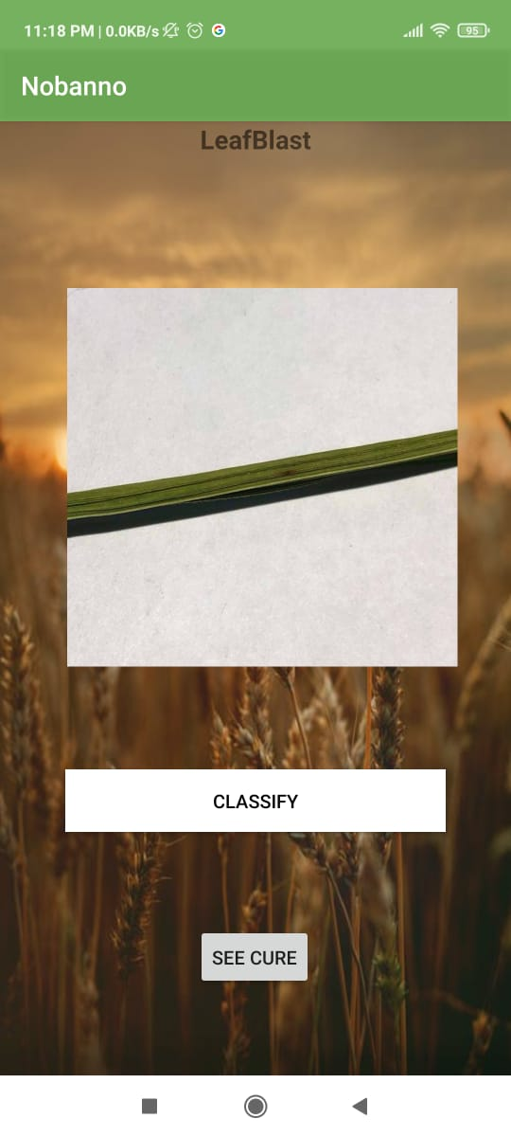
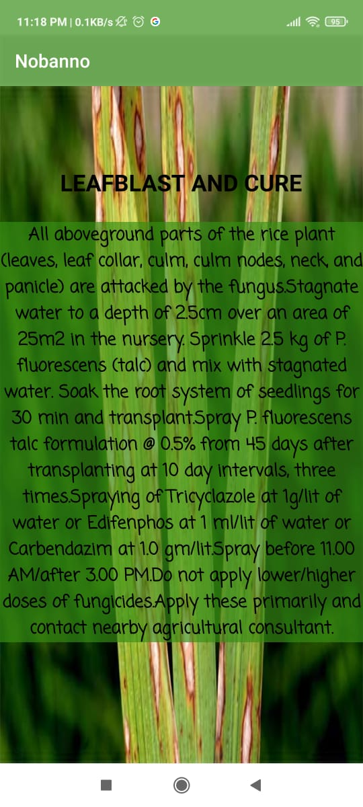
App Layout
Date: 24.06.2021

Slide 19
Limitations
This application can only detect three rice plant diseases ( Leaf Blast, Brown Spot and Hispa)
Only provides primary treatments of the diseases.
Doesn’t give information about weather.
Doesn’t give information about production of crops.
Date: 24.06.2021

Slide 20
Reference
J. S. S. Phadikar, ”Rice disease identification using pattern recognition techniques.,” in Proceedings of the IEEE International Conference on Computer and Information Technology (ICCIT), Khulna, Bangladesh, 2008.
Syeda Airas Burhan, Dr. Sidra Minhas, Dr.Amara Tariq , “Comparative Study Of Deep Learning Algorithms For Disease And Pest Detection In Rice Crops”
Preetom Saha Arko, Mohammed Eunus Ali, Sajid Hasan Apon “Identification and Recognition of Rice Diseases and Pests Using Convolutional Neural Networks”
Kawcher Ahmed, Tasmia Rahman Shahidi, Syed Md. Irfanul Alam and Sifat Momen “Rice Leaf Disease Detection Using Machine Learning Techniques” in Proceedings of the 2019 International Conference on Sustainable Technologies for Industry
Date: 24.06.2021

Slide 21
THANK YOU

